Slide 1

Hudspeth County Solid Waste Management
This Photo by Unknown Author is licensed under CC BY-SA

Slide 2
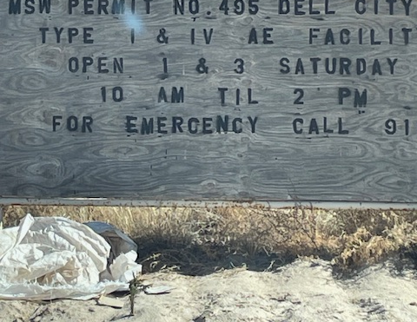
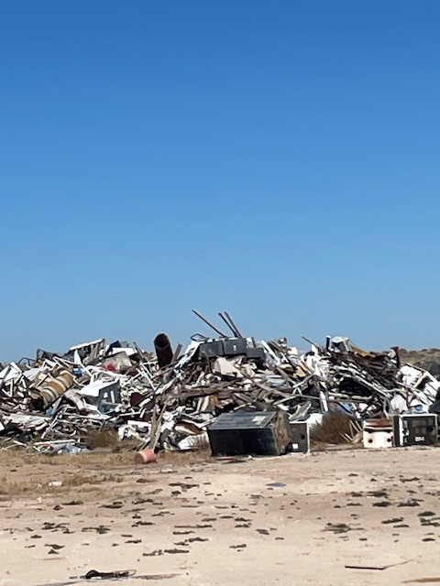
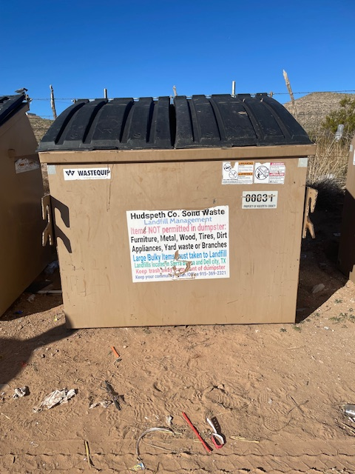
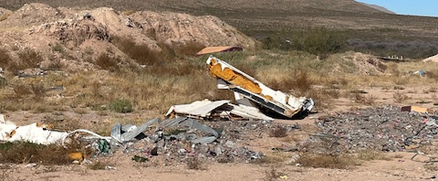
The Current Solid Waste Operations are a Burden on the County, Out of Compliance and Plagued with problems

Slide 3
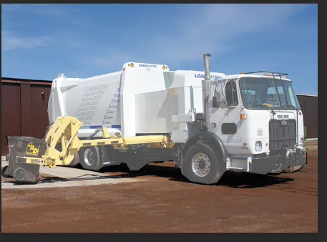
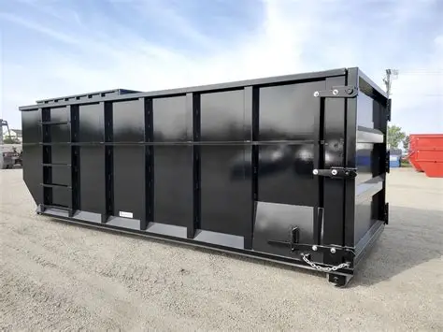
An Action Plan is Needed
Hudspeth County applied, and was award a grant to hire a consultant that specializes in Solid Waste
They were tasked to ID the problems
Provide possible Solutions

Slide 4
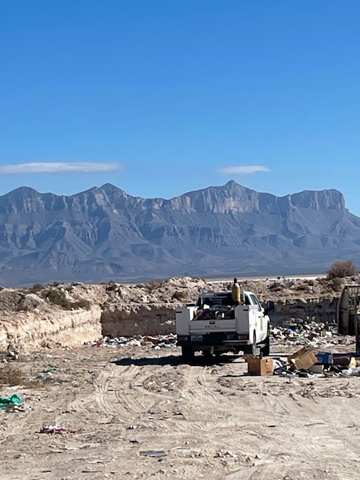
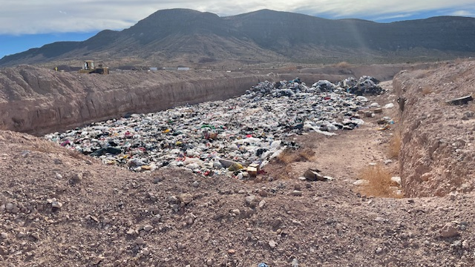
Modern Landfills are expensive and require Regulatory Compliance Hudspeth County has Two
Dell City
Serves a population of 1000
Takes in 20 tons a week
That is one modern Waste Truck
Sierra Blanca
Serves the rest of the County
Receives 100 tons per week

Slide 6
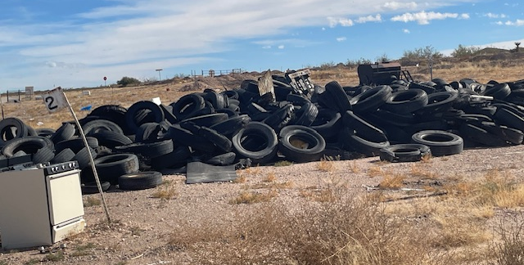
Compliance Issues
Both Facilities have regulatory compliance Issues
Regardless of what Option the County decides these must be addressed:
Facility Survey
Fencing
Signage
Permit Modification
Record Keep and Reporting

Slide 7
Current Collections & Billing
Currently there are 665 dumpster being serviced
Appears to be too many and may need to be cut by 25 percent
92 Commercial •52 Government (11 duplicates on the commercial list) •120 Dell Residential •140 Sierra Blanca Residential •226 Ft Hancock Residential •43 Unknown service 7-Dell; 13 SB; 22 FH; 1 ESP
Need to determine if all dumpster and being utilized

Slide 8
Billing & Financial
Hudspeth County Billing Agents for Waste Hudspeth County Water Control & Improvement District #1 915-369-2221 Judy Virdell Ft. Hancock Water Control & Improvement District 915-769-3931 Cerro Alto Water System 915-590-4441 11900 Montana Ave Vicente Salido 719-492-9903 Dell City Water Utility 915-964-2344 Michille Burford El Paso Water Utility 915-594-5500 Luis or Rick
These contracts need to be Audited and Updated
Financial Assurance Required for Closure & Post Closure Costs
Financial Assurance (30 TAC 330, Subchapter L, and 30 TAC 37, Subchapter R)
MSW facilities are required to demonstrate financial assurance for closure, post-closure, and corrective-action costs. They must be able to show that they are capable of paying the projected costs of closing the facility and the associated 30 years of post-closure, as well as the costs of any required corrective action. The following mechanisms can be used to demonstrate financial assurance: a trust fund, a surety bond guaranteeing payment or performance, insurance, or a corporate financial test.
2001 Estimates 2025 Estimates
Closure = $59,758 Closure = $110,000 Post Closure = $389,758 Post Closure =$731,735 Total = $449,516 Total = $841,735

Slide 9
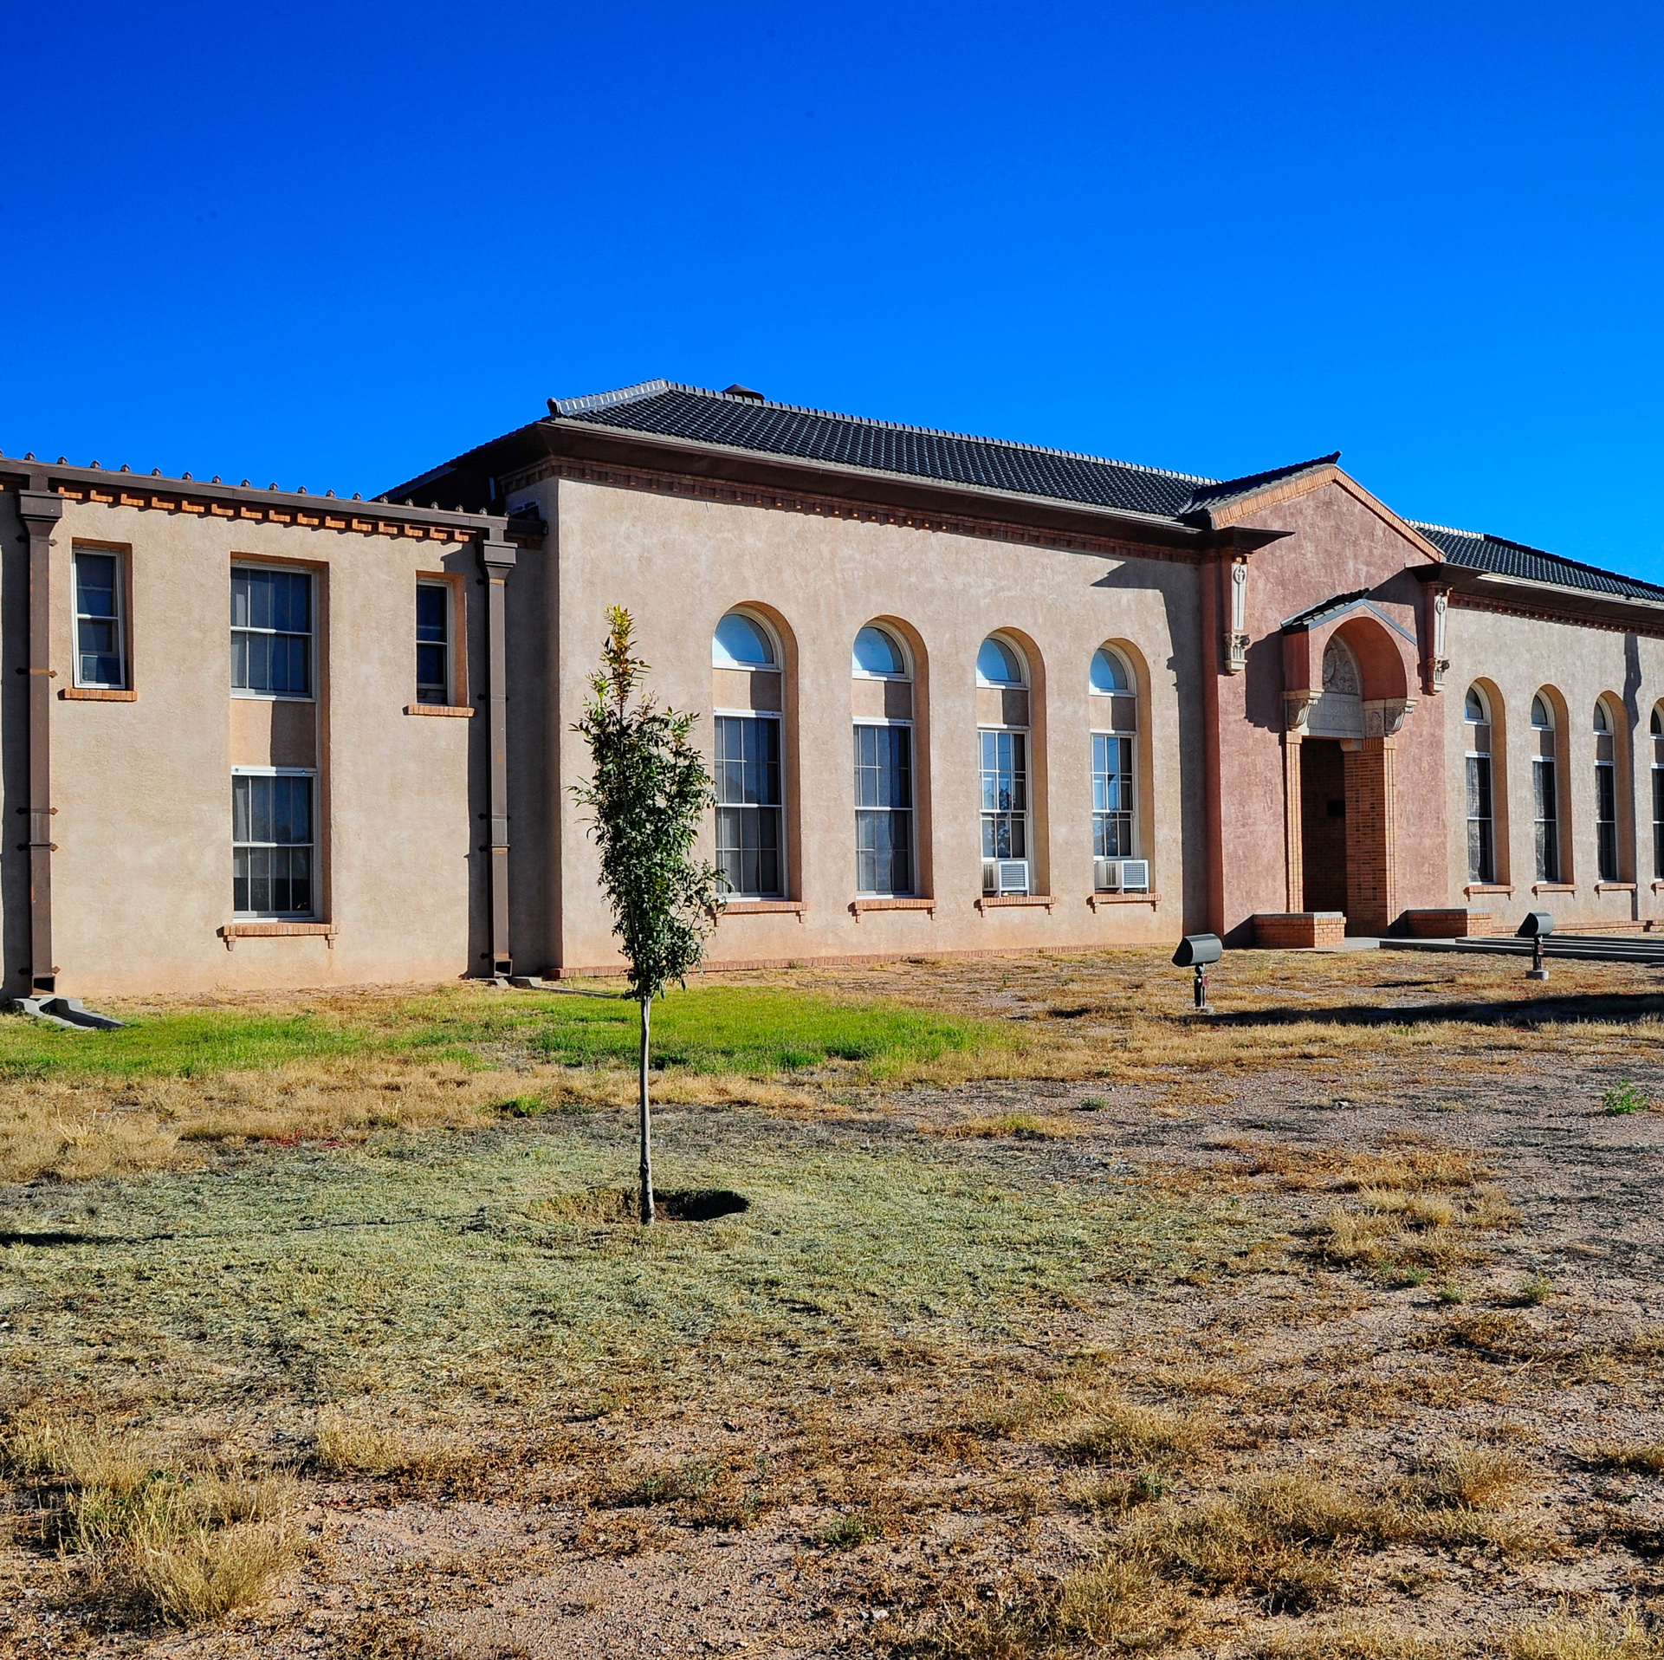
Proposed Rates and fees for Disposal Services
New rates will need to be implemented to cover
$220,000/ year operational Shortfall
$842,000 Closure Post Closure Estimates
County has used up all funds in reserve account over past 5 years
Other tax dollars are used for other county programs such as the prison, sheriff, roads

Slide 12
Notes:
NOTE: Texans on average produce 7.24 pounds per person per day = 1.3 tons/year. 3200 pop x 1.3 = 4160 tons. Trash production in Hudspeth County is about 25% higher than average.

Slide 13

PROPOSED OPERATIONS

Slide 14
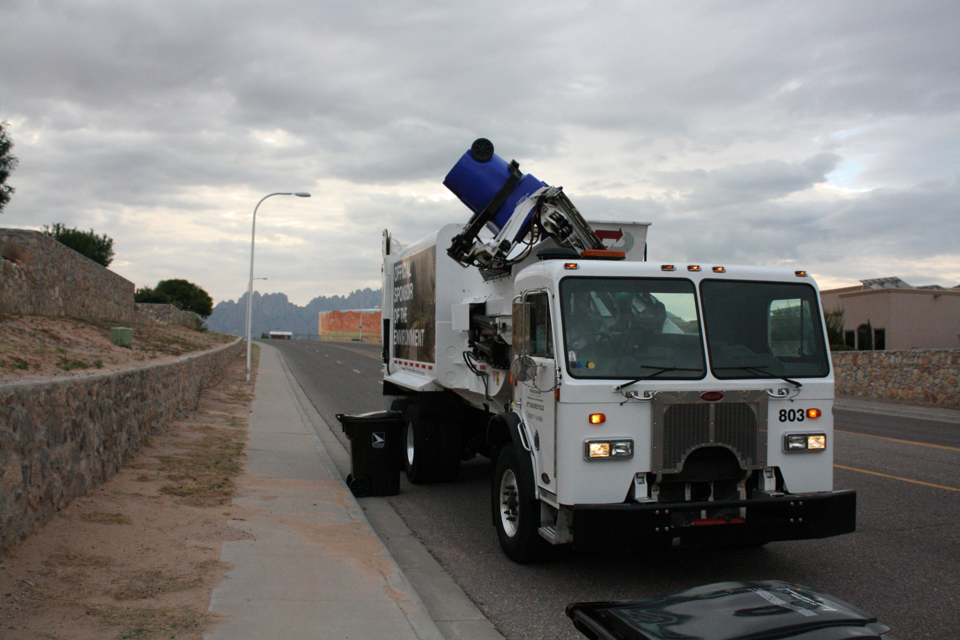
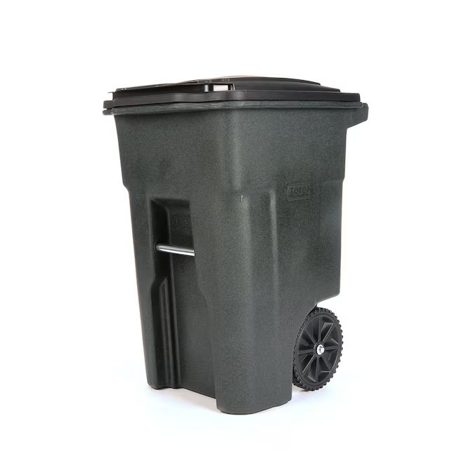
Modernize service levels were possible
90-gallon dumpster

Slide 15
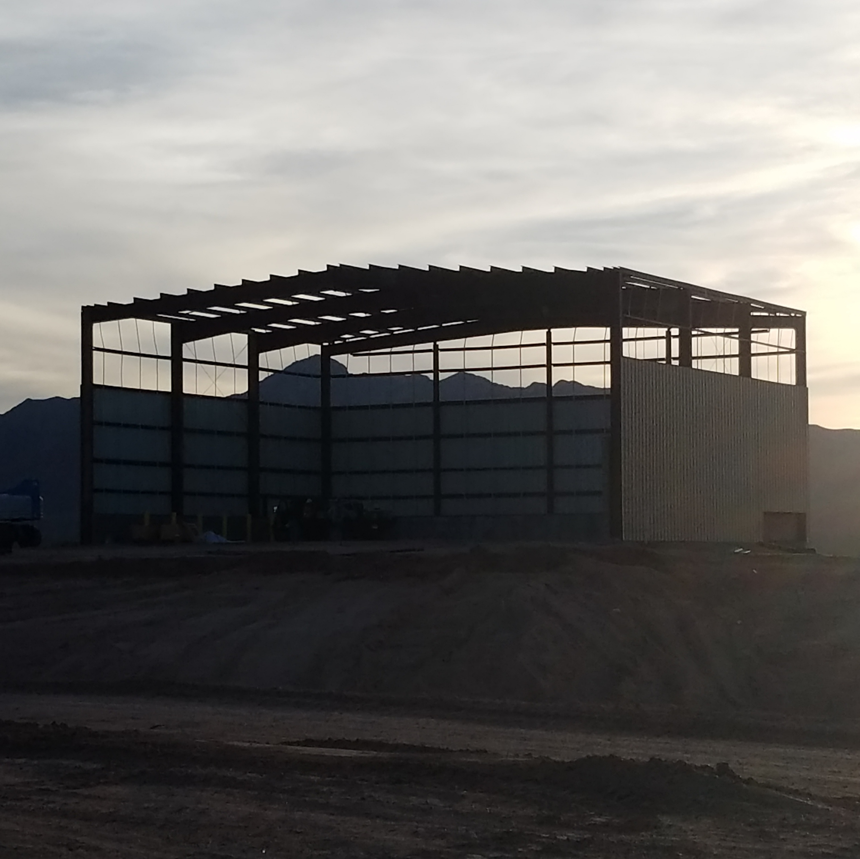
Citizen Collection Centers
Explore building new collection centers
Benefits
Safety
Customer Friendly
Less expensive to Operate

Slide 16
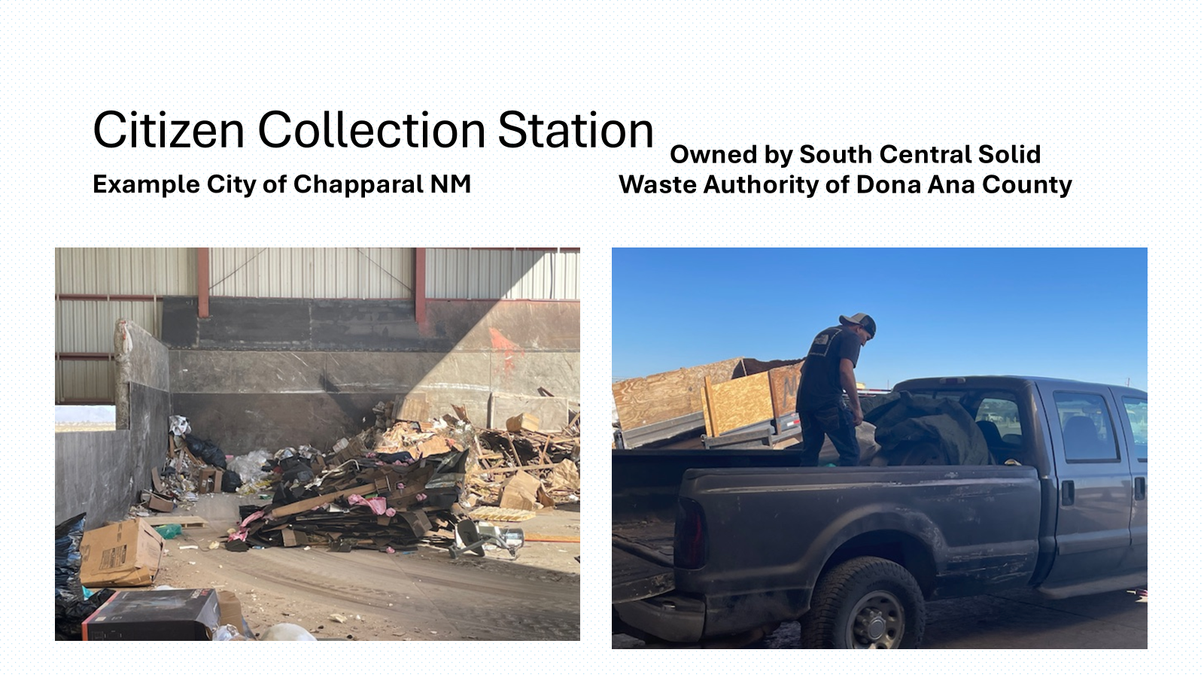

Slide 17
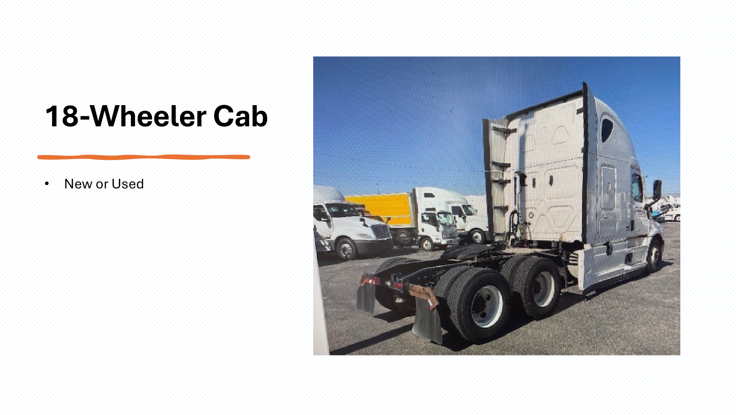

Slide 18
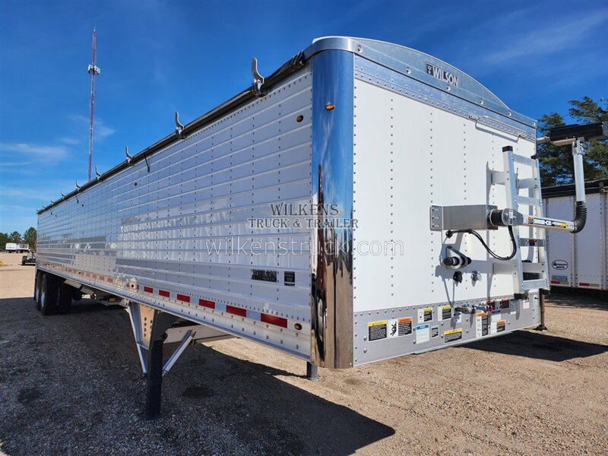
Walking Floor Trailers

Slide 19
Roll-Off Container
40 cubic yard containers $5000 each

Slide 21

Questions?
Ellen Smyth; 915-760-1643
Patrick Peck; 575-642-1549

